Slide 1
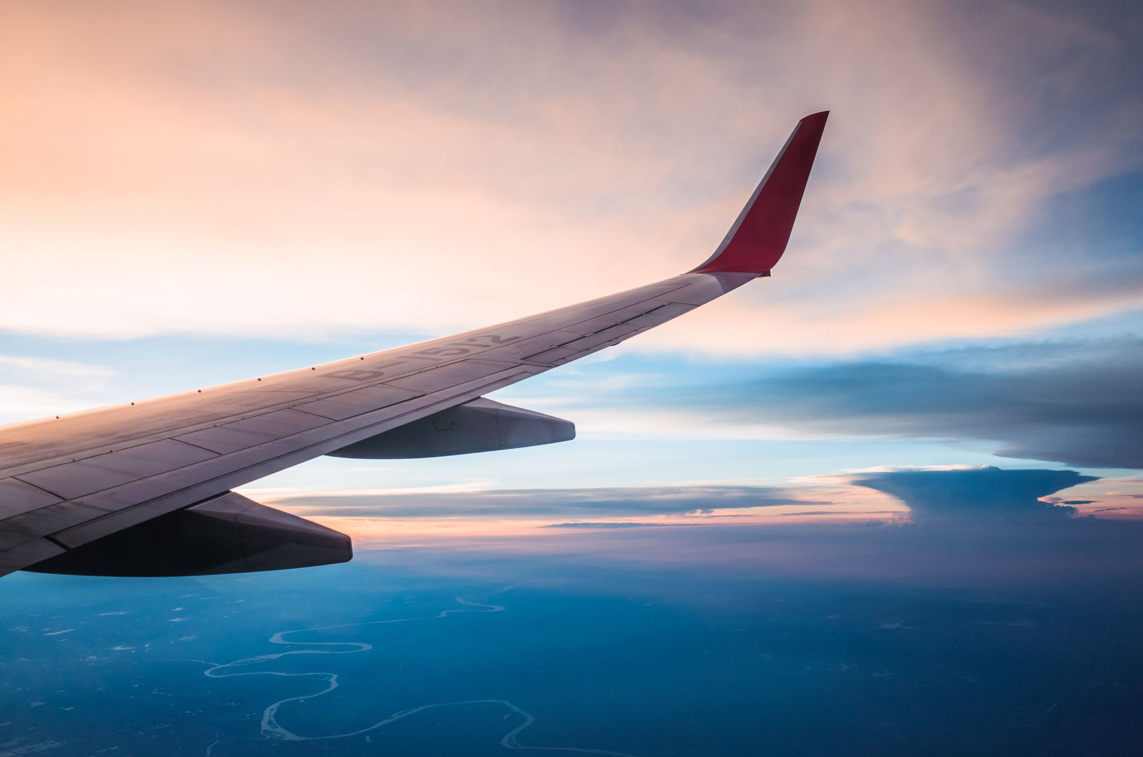
JetBlue
July 2023
Phalanx Analysis Group

Slide 2
Table of Content
Problem Statement and Understanding
Most Profitable Round Trip
Routes on Location factor
Breakeven point and KPI’s
Recommendations

Slide 3
Problem Statement
We want to know five new airplanes that provide most profitable round trip flights to enter the United States domestic market.

Slide 4
Understanding
One airplane takes a round trip route.
Punctuality is an important key for brand image
Company’s Motto:
” On time,
for you”
Only considering Medium and Large-sized airport.

Slide 5
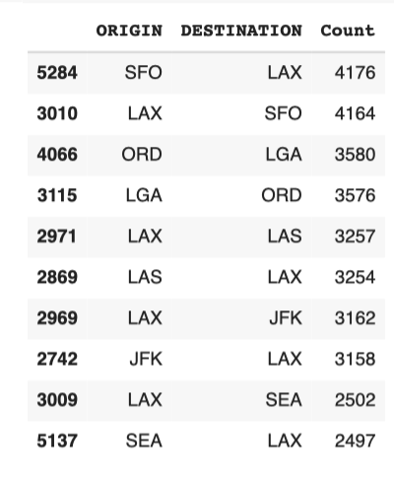
10 Busiest Round-Trip Routes

Slide 6
10 Most Profitable Round-trip Routes
* Without upfront airplane Cost
Profit =
Total Revenue- Total Cost
Revenue Equation:
y = [200(Occupancy Rate) * $70] /2
+ Ticket Price
Cost Equation:
Y = Maintenance Cost + Operational Cost + Arrival Penalty + Departure Penalty

Slide 7
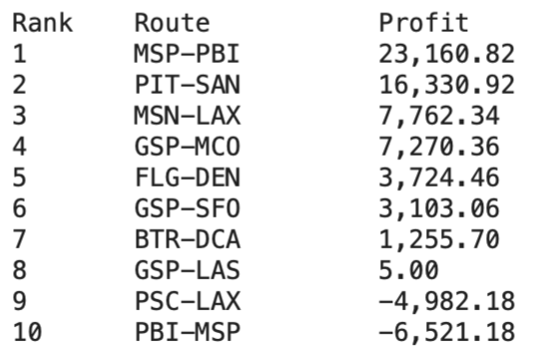
10 Most Profitable Round-trip Routes Without upfront airplane Cost - Summary
Total Revenue: 8720522540.963951
Total Cost: 50851857313.32
Total Profit: 51109.29999999999

Slide 8
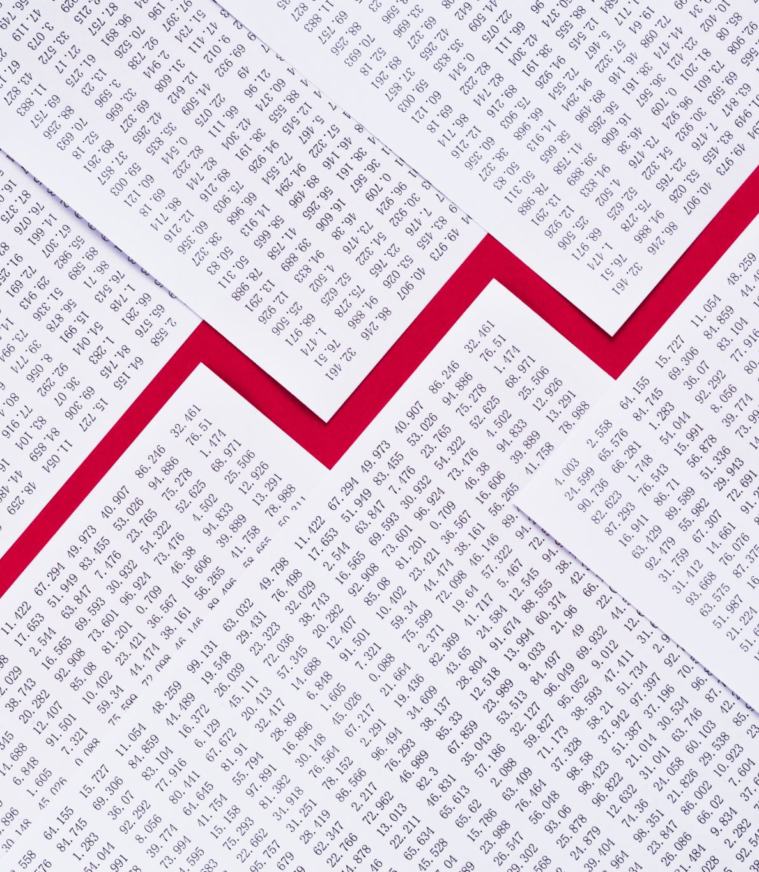
Examples of factors to recommend investing
Dates ( x )
Location ( x )
Number of tickets ( O )
Ticket Price ( O )
Price difference for passengers ( O )
Increase in Baggage Cost (O)

Slide 9

Strategy Theories
Upfront Cost for Each airplane = $ 90 million
Factors Content
Number of tickets: sell more tickets
Ticket Price: make ticket price double
Increase in Baggage Cost: double the baggage Cost.
Price difference for passengers: 10% = ticket price * 10
50% = ticket price * 2
40% = regular ticket price

Slide 10
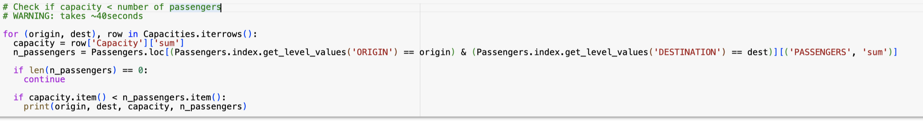
Check if Capacity < Number of Passengers
After Checking, we are still Capacity > Number of Passengers
So, we they can hold more people inside the plane.

Slide 11
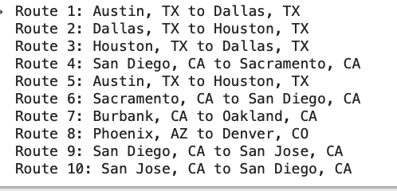
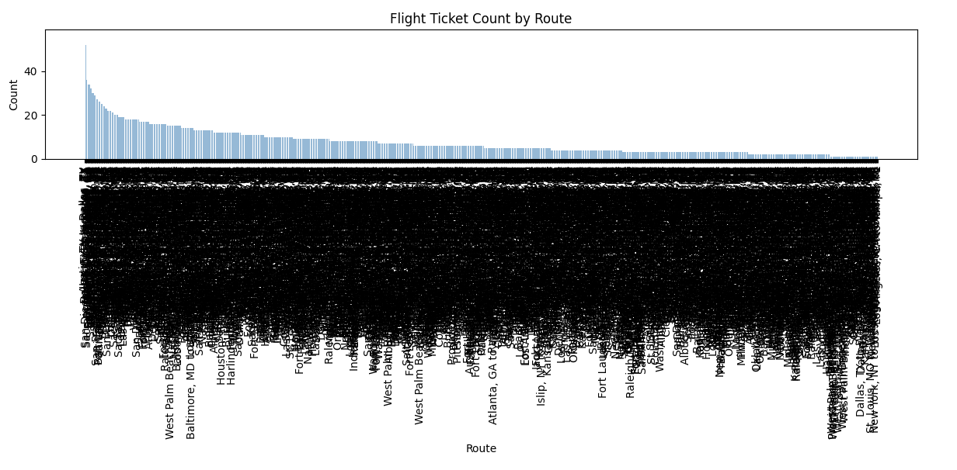
5 Round Trip Routes on Location Factor

Slide 12
Change in number of tickets
Original number of tickets: 200 tickets.
200 tickets yield about $51109.3 of profit.
Upfront Airplane Cost = $90 million.
Thus, selling about 1000 tickets would provide breakeven point.

Slide 13

Change in Ticket Price
Double the price or times 2.3 gives a closer value to the breakeven point.
Profit at original price = $51109.3
Profit at doubled price = $ 8,843,176

Slide 14

Change in Baggage Cost
Times about 4 to the original baggage cost gives closer value to the breakeven point.
Profit at original price = $51109.3
Profit at (price * 4) = $ 55,942,990

Slide 15
Price difference for Passengers by Class
We differentiate the ticket price depending on their classes such as First, Business, Economy.
Price difference for passengers: First Class (10%) = ticket price * 10
Business Class (50%) = ticket price * 2
Economy Class (40%) = regular ticket price

Slide 16

KPI’s
Number of customer who visit the website.
MAU (Measure of engagement for a particular product or object)
Opportunities Won : number of opportunities of ticket sale that actually result in a sale.
CAC (Customer acquisition cost)
: how much an organization spend to acquire new customers.
Sale Cycle : Average number of days a ticket sold exists from it’s creation to it’s close date.
Customer Lifetime Value : Expectation to earn from a customer during the entire relationship with us.

Slide 17
Recommendation
According to the price sensitivity, increasing the ticket price is easier to meet the breakeven point instead of increasing the number of tickets to be sold. Because, wealthier people are likely to be less sensitive about the increase in price than the less wealthy people.

Slide 18
JetBlue
July 2023
Phalanx Analysis Group

